Slide 1
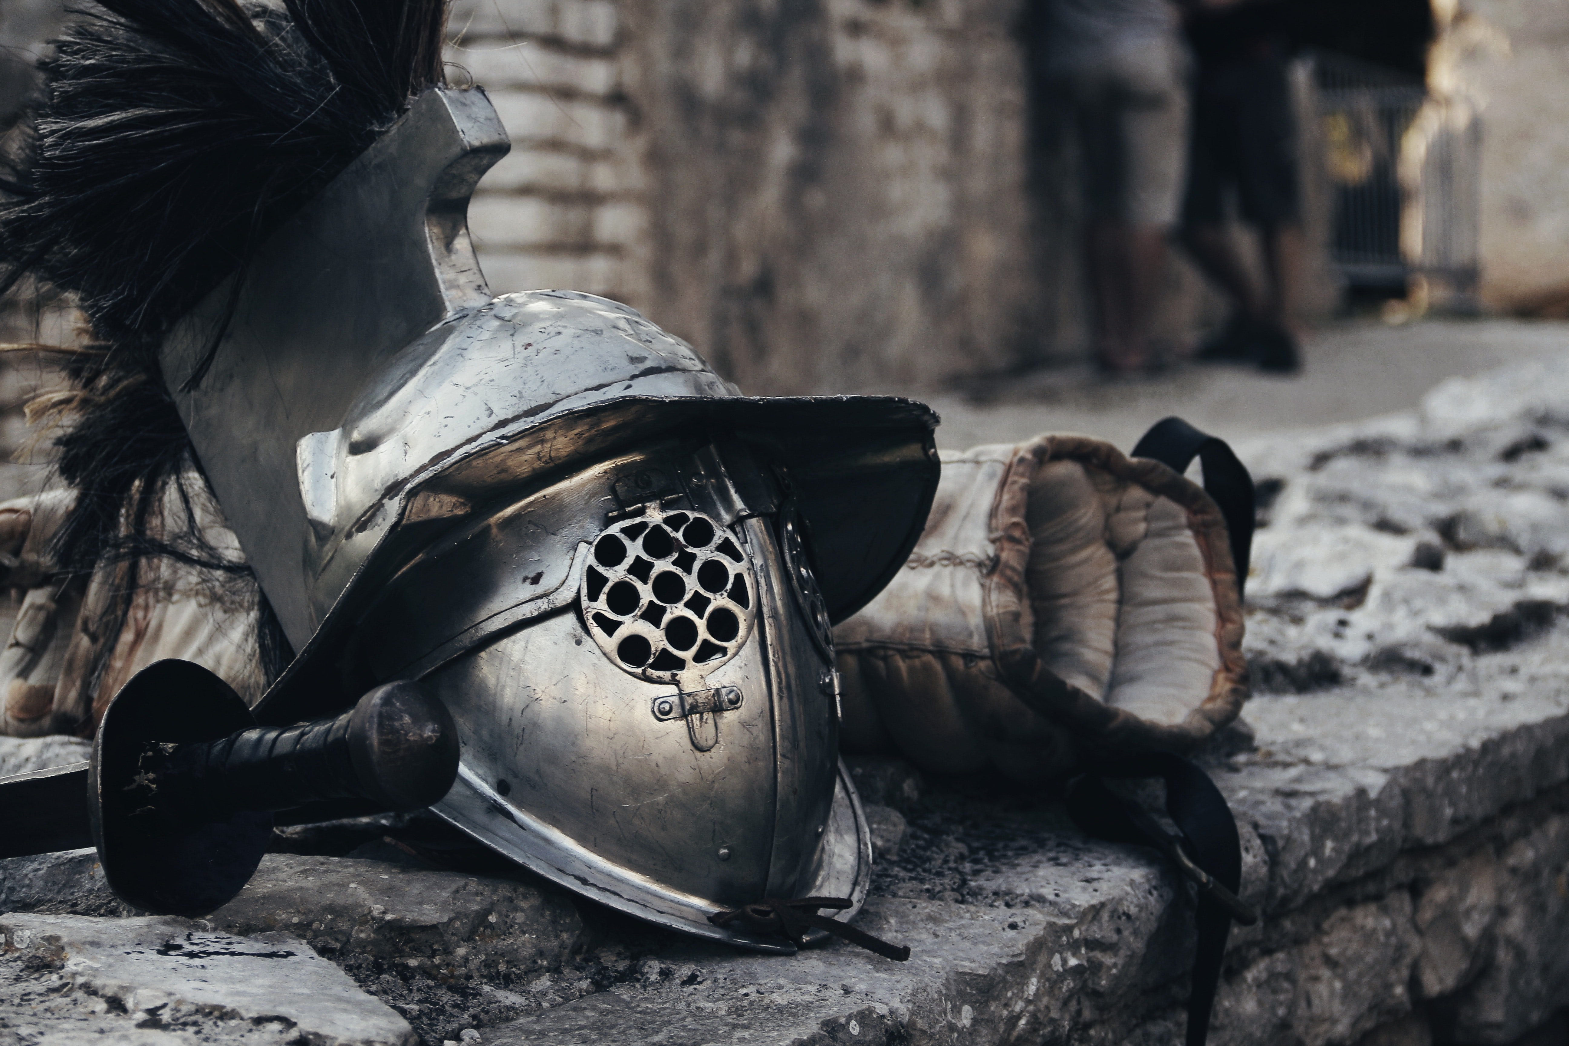
Magic TOWER
Wang Zixiao Wang Tao
Zeng Zhaowei Sun Jiatong
Group 8

Slide 2

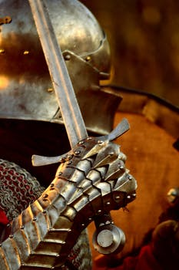
1
Introduction
2
Analysis
CONTENTS
3
Design&Implement
4
Testing
5
Conclusion

Slide 3

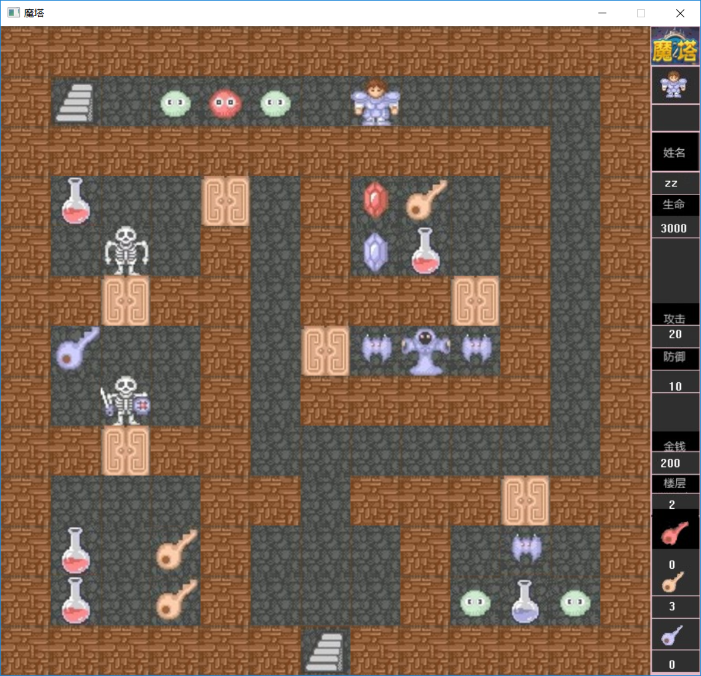
Introduction
• Magic Tower is really a non-linear puzzle game disguised as an RPG.
• Magic Tower appears to be RPG-style; you have attack strength, defense strength, and a health bar, and so do all the monsters. You can increase your health (without limit) by drinking potions, and increase your attack and defense strength by collecting crystals and improved equipment, as well as by donating gold to the altars on various floors. Since the combat is completely deterministic, it is actually a puzzle. Your exact path is up to you absolutely.
"It may seem that the story is usual. Brave man is trying to save princess caught in the tower. But this is not so usual and normal story. Well, this story is even not from this game. Why? Check this while playing."

Slide 4
Analysis
We require:
a map designed logically;
to judge the element the prince meets and according to it do a certain thing. For example, go upstairs when meeting an upstairs ladder;
to move controlled by the keyboard;
to save the game so that the player can continue to play the unfinished game;
to show the dialogue when meeting an NPC;
proper parameters for playability, such as the attack and defense strength of each monster;
to calculate the losing HP for each monster (according to the property of the player);
to give some property, such as a key or attack strength, when the player buys it in a shop;

Slide 5
Design &Implementation
Control
&
Graphical Interfaces
for presentation

Slide 6
For Control
START
‘w’ ‘a’ ‘s’ ‘d’
‘i’
‘p’
‘o’
or
or
or
Save the data of this play
Pause the system
End this game
Keep moving
Fighting with the monsters
load the data of this play
The hp of the player ≤0
END
No
Yes

Slide 7
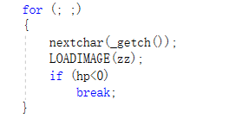
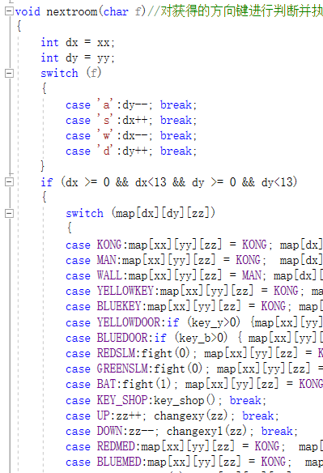
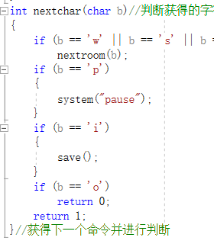
For Control

Slide 8
For graphical interfaces
Start
Definition
Locating the specified place
Load in maps and materials
Output the specified information
Types of the maps binary array
putimage
End

Slide 9
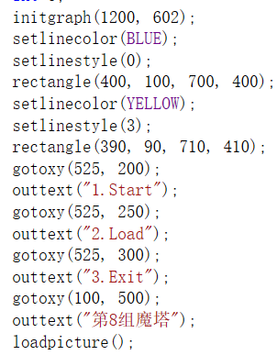
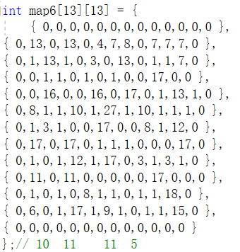
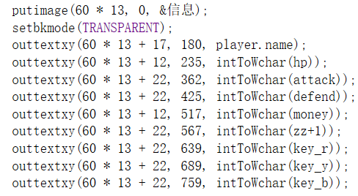
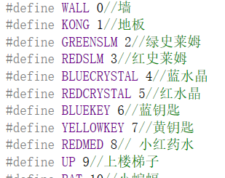
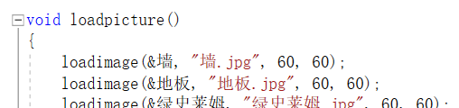
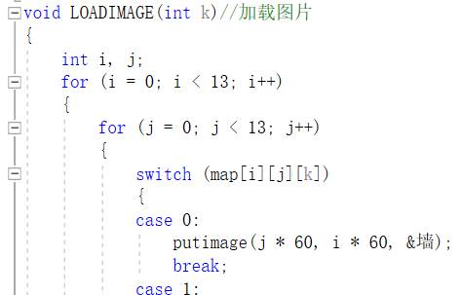
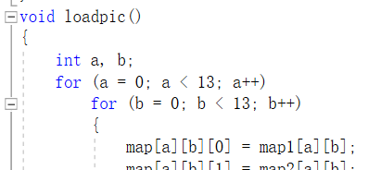
For graphical interfaces

Slide 10

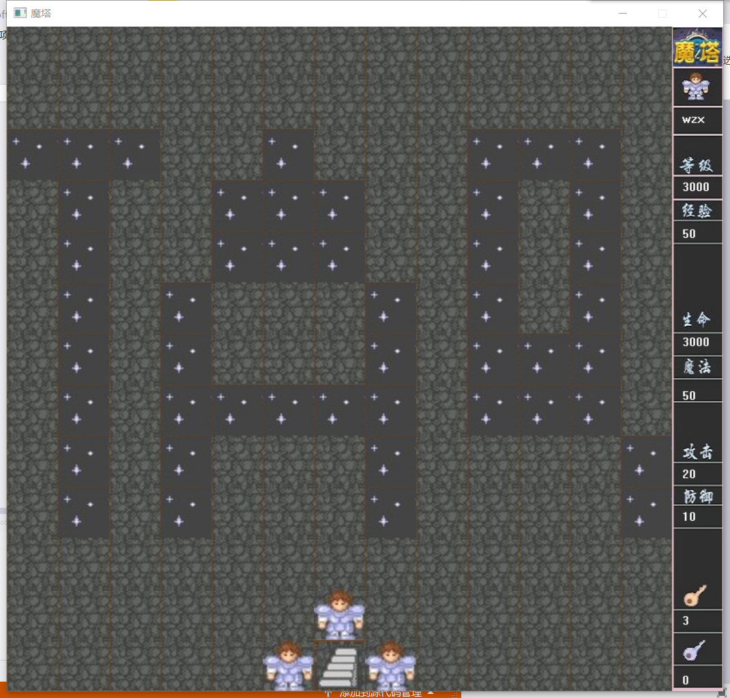
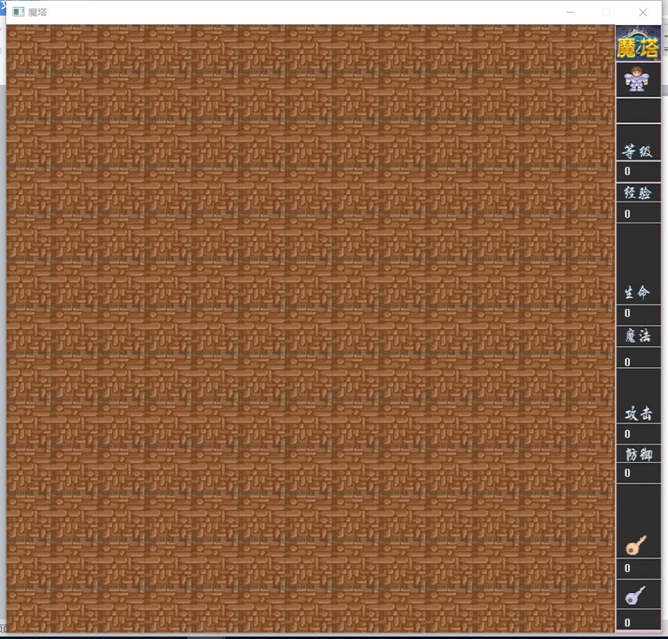
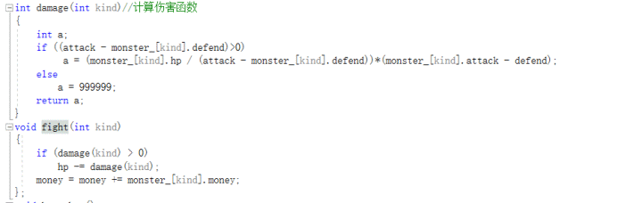
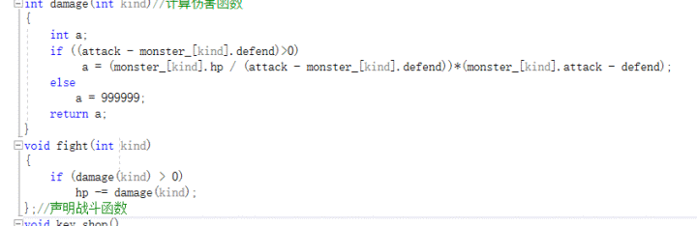
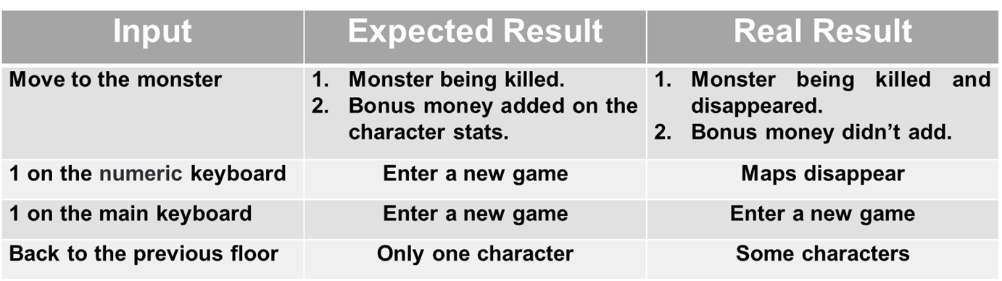
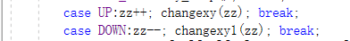
Testing

Slide 11
Conclusion
After the efforts during the whole semester, our group members have realized the main purpose to build a playable and enjoyable game together. We finished the coding parts,the designing of the maps and the testing and debugging part. In the testing and debugging part we found several problems of our design and document. We can see that the little error of the ‘seemingly-right ’ idea can never be found only when we try to examine it during the part of execution. Distributing properly and creating a culture of team spirit is the way to make the project finished more effectively. We really feel grateful to C program.

Slide 12
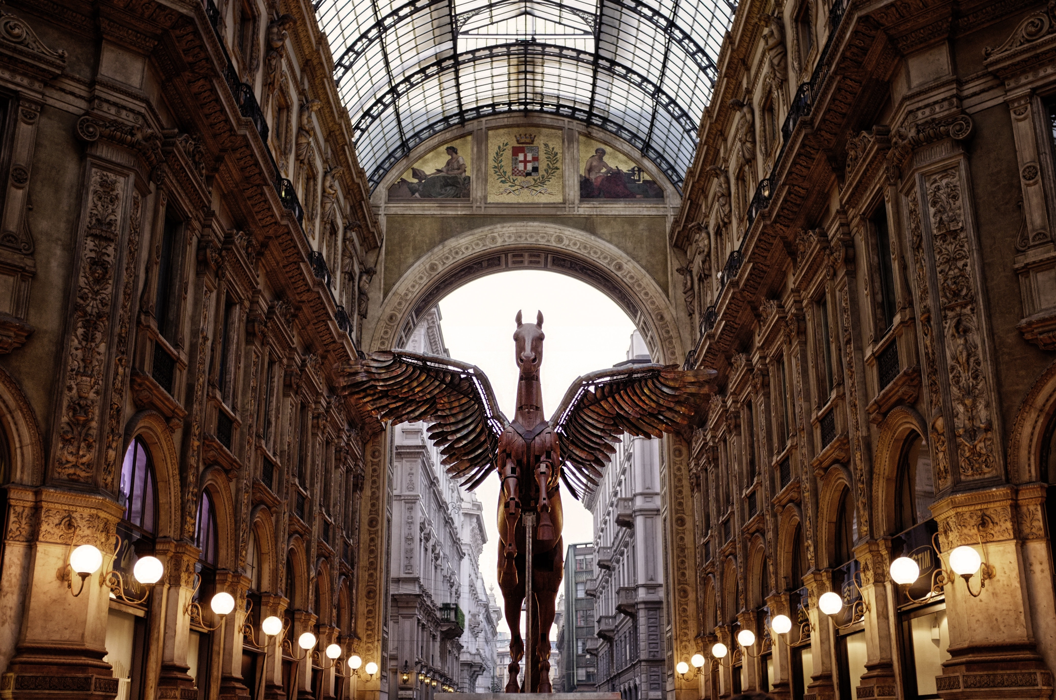
Thank You!

